Slide 1

SOFTWARE ENGINEERING PROJECT
Library Management System
UML Design
Course: Software Enterprise: Personal Process and Quality
Contributors:
Khondamir Tuychiev • Boburjon Komilov • Abdulaziz Maxammadjonov

Slide 2
Project Overview
What
Why UML
Problems Solved
A comprehensive Library Management System designed to automate and streamline library operations including book cataloging, member management, and transaction processing.
UML modeling provides a visual blueprint of the system before implementation, enabling clear communication of requirements, structure, and behavior among stakeholders.
Manual book tracking inefficiency
Limited member access control
Overdue management challenges
Catalog maintenance complexity

Slide 3
System Features
Registration & Login
Book Search & Reservation
Secure user authentication and account management for members and librarians
Advanced catalog search with filtering and reservation capabilities
Issue & Return Books
Catalog Management
Streamlined borrowing process with automated tracking and status updates
Comprehensive book database management with add, update, and remove functions
Fine Handling
Automated overdue detection, fine calculation, and payment processing with notification system

Slide 4
UML Diagrams Used
Use Case Diagram
Purpose: Defines system functionality from user perspective — shows what the system does and who interacts with it
Class Diagram
Purpose: Models static system structure — shows classes, attributes, methods, and their relationships
Sequence Diagram
Purpose: Shows dynamic interaction flow — illustrates how objects communicate over time to complete operations

Slide 5
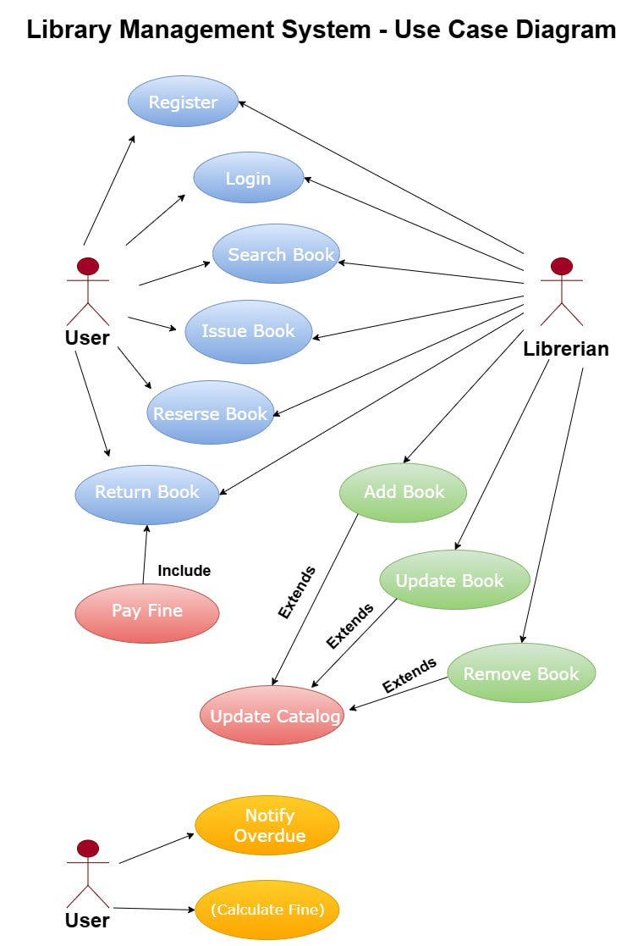
Use Case Diagram — Purpose
Use Case Diagram
Shows System Functionality
Visualizes all features and capabilities the system provides to its users
Actor Interactions
Maps relationships between users (actors) and system functions they can perform
User Perspective
Presents the system from an external user's viewpoint, not technical implementation
Requirement Modeling
Captures functional requirements in a format understandable by all stakeholders

Slide 6
Actors and Use Cases
Actors
Main Use Cases
User
Search
Issue
Library member who searches, borrows, reserves, and returns books
Return
Reserve
Librarian
Update Catalog
Administrator who manages books, verifies members, and maintains catalog
Key Relationships
System & Database
Include: Return Book → Pay Fine
Processes transactions, business logic, and persistent data storage
Extend: Update Catalog ← Add/Update/Remove
Association: Actors connect to permitted actions

Slide 7
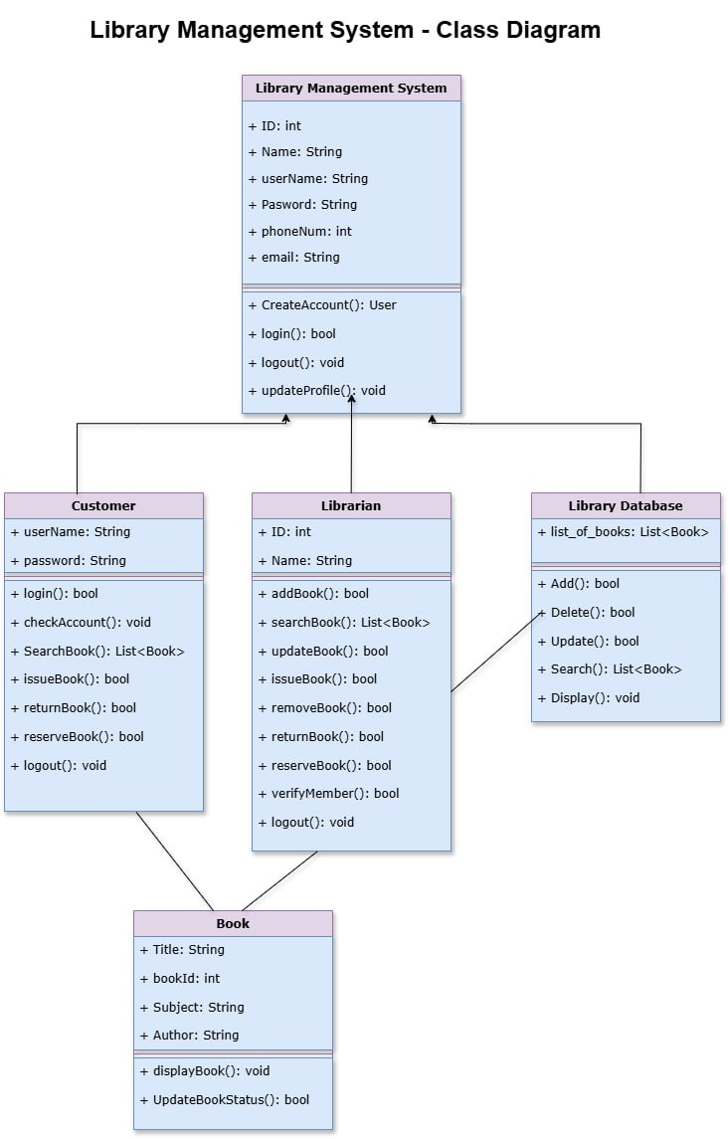
Class Diagram — Purpose
Class Diagram
Shows System Structure
Represents the static architecture and organization of system components
Classes, Attributes, Methods
Defines data members (attributes) and behaviors (methods) for each class
Relationships
Illustrates associations, dependencies, and interactions between classes
Relationship Types
Association
Usage Dependency
System Coordination

Slide 8
Main Classes
Customer
Librarian
Responsibility: Represents library members who can search, borrow, reserve, and return books through their account.
Responsibility: Manages library operations including catalog maintenance, member verification, and book transactions.
login()
searchBook()
issueBook()
returnBook()
reserveBook()
addBook()
updateBook()
removeBook()
verifyMember()
Book
LibraryDatabase
Responsibility: Encapsulates book information and manages book status throughout its lifecycle in the library.
Responsibility: Handles persistent storage and retrieval of all library data including books and member records.
title
bookId
author
displayBook()
updateBookStatus()
add()
delete()
update()
search()
display()
LibraryManagementSystem
Responsibility: Central coordinator that manages user authentication, account creation, and system-wide operations.

Slide 9
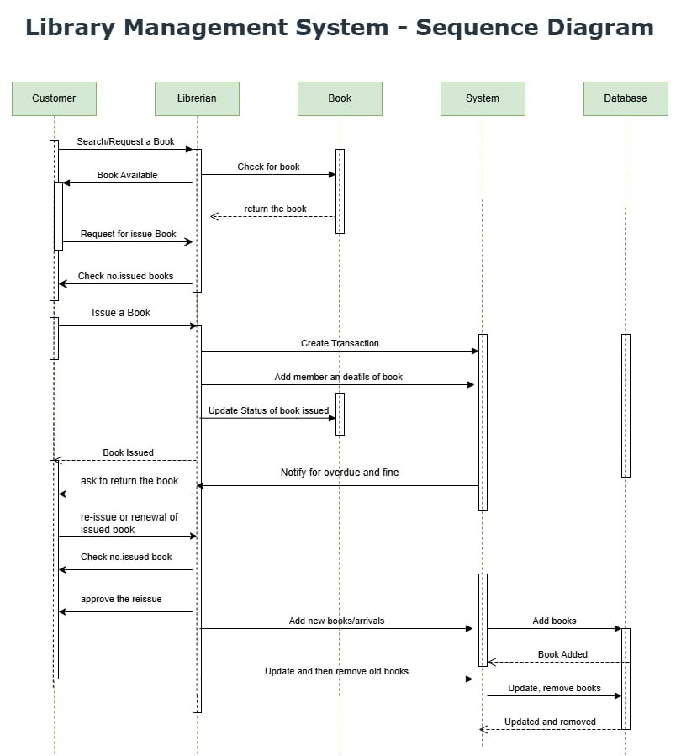
Sequence Diagram — Purpose
Sequence Diagram
Runtime Interaction Flow
Illustrates how objects communicate and collaborate during system execution
Book Issuing Process
Models the complete transaction flow from search request to book issuance
Time-Ordered Messages
Shows chronological sequence of method calls and responses between objects
Additional Flows Modeled
Book return and renewal
Overdue notification
Fine calculation
Adding new arrivals
Updating/removing books

Slide 10
Sequence Flow Summary
Book Issuing Process — Step by Step
1
2
3
Search Request
Availability Check
Issue Request
Customer searches or requests a specific book from the catalog
Librarian verifies book availability and member eligibility
Customer formally requests to borrow the available book
4
5
6
System Transaction
Database Update
Confirmation
System creates transaction record and updates book status
Database stores transaction and updates book availability
System confirms successful book issuance to customer

Slide 11
Use Case vs Class Diagram
Aspect
Use Case Diagram
Class Diagram
Focus
System functionality
System structure
Answers
What does the system do?
How is the system built?
Viewpoint
User perspective
Developer/design perspective
Level
High-level behavior
Detailed static design
Primary Use
Requirements gathering
Implementation planning
Audience
Stakeholders, clients
Developers, architects
Key Insight
Use Case Diagrams define what needs to be built, while Class Diagrams define how it will be built. Together they connect user requirements with technical structure.

Slide 12
Benefits of UML Modeling
Better Requirement Clarity
Early Design Validation
UML diagrams provide a visual representation of requirements that is easily understood by all stakeholders, eliminating ambiguity and ensuring everyone shares the same understanding of system functionality.
Modeling before coding allows teams to identify design flaws, inconsistencies, and missing requirements early in the development cycle, when they are easier and less costly to fix.
Reduced Errors
Better Team Communication
By visualizing system structure and behavior beforehand, potential issues in architecture, class relationships, and interaction flows can be caught and resolved before implementation begins.
UML serves as a common visual language that bridges the gap between technical and non-technical team members, facilitating clearer discussions and more effective collaboration.

Slide 13
Conclusion
UML helped design before coding — providing a clear blueprint that guided implementation and reduced development risks.
Diagrams complement each other — Use Case, Class, and Sequence diagrams together provide a complete view of system functionality, structure, and behavior.
System design is clear and structured — ready for implementation with well-defined requirements, architecture, and interaction flows.
Thank You
Questions & Discussion

